Slide 1
Operating system
Part III: Process [进程] & Thread [线程]
Know data structures to maintain the resources needed
when executing your program
By KONG LingBo (孔令波)

Slide 2
Process
To understand the execution of your program
Process [进程] is the traditional concept
The identification to manage the needed information to run one program (OS’s or user’s)
PCB is the data structure to record the necessary information: resources (MM, ownership, security, …), execution stages/states, …
Additional data structures and algorithms are needed to manage the concurrent execution of many programs
Queues, and schedulers
Inter-process communication (IPC)
Thread[线程] is the modern concept
The idea could be seen as Multiplexing process, namely that your program is constructed to have more than one execution units
CPU is occupied by the process, however the usage of the CPU is shared among the internal execution units (threads)
The resources assigned to the process could be shared by those threads.

Slide 3
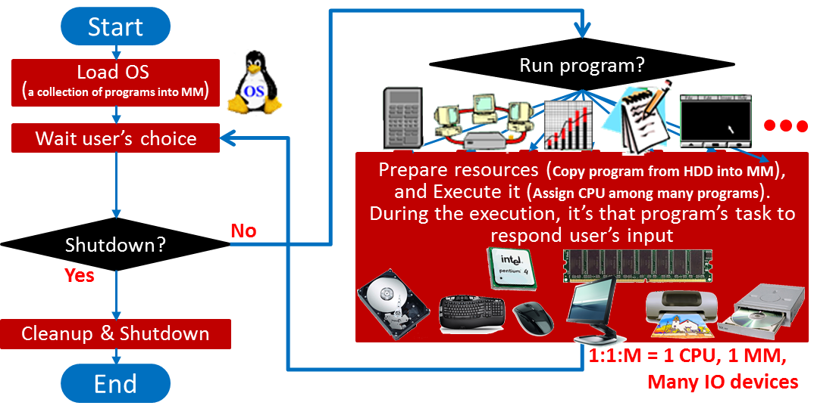
We have learned the detailed diagram
Inside OS, I prefer to call the collection of necessary resources to execute your program + program itself as Process[进程]!
How exactly are those programs controlled by OS?

Slide 4
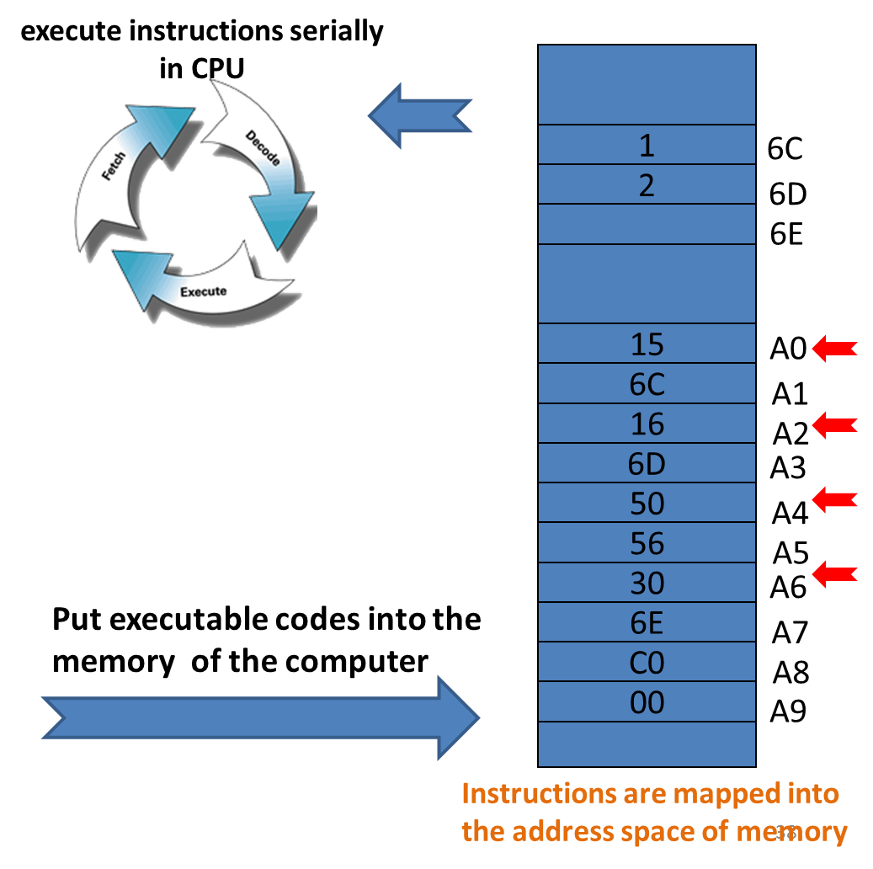
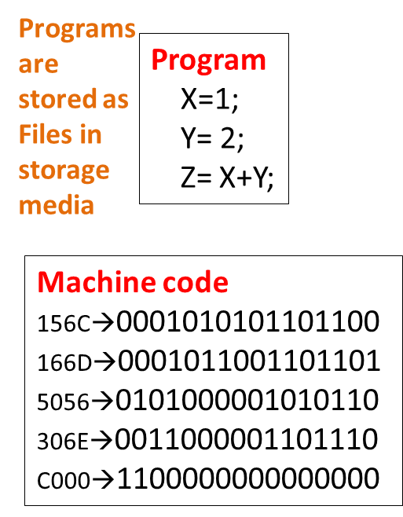
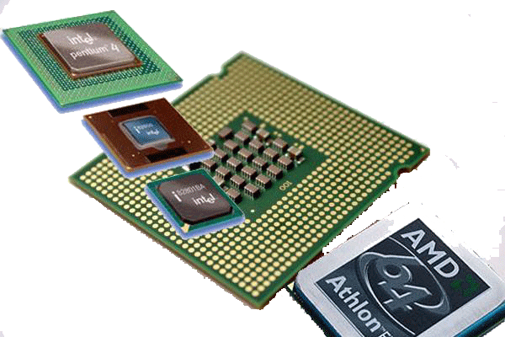
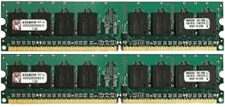
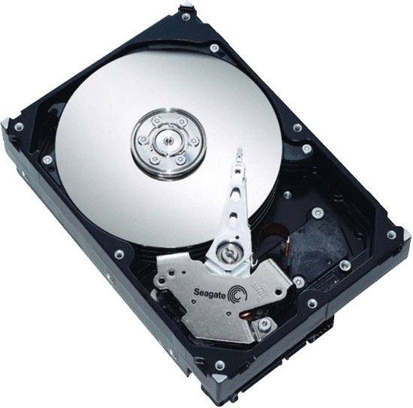
The execution of your program needs some support
HDD

Slide 5
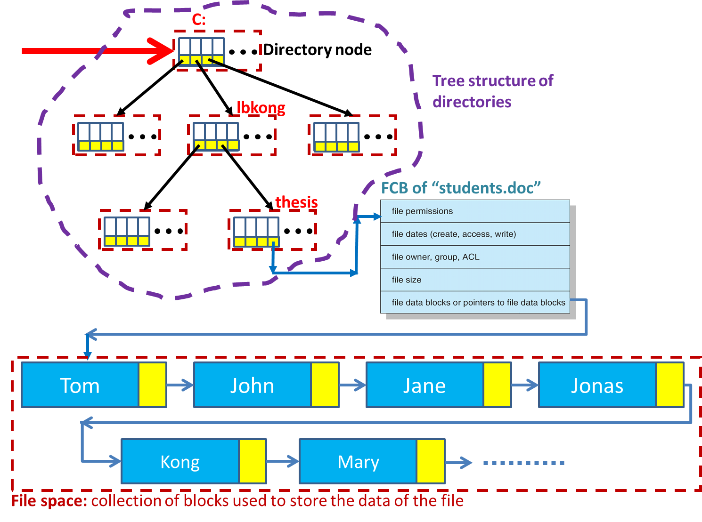
To support the execution of a program, we need to record some information (define some data structure) – besides the program itself
Where is your program stored in the HDD?
Project file contains the organization information.
We need information to locate that project file in HDD
We’ll learn this how in later chapter: IO + File
Notes:
以后会了解到, 磁盘上的文件管理, 就像是苹果挂在树上 – 先有树, 然后才是挂.

Slide 6
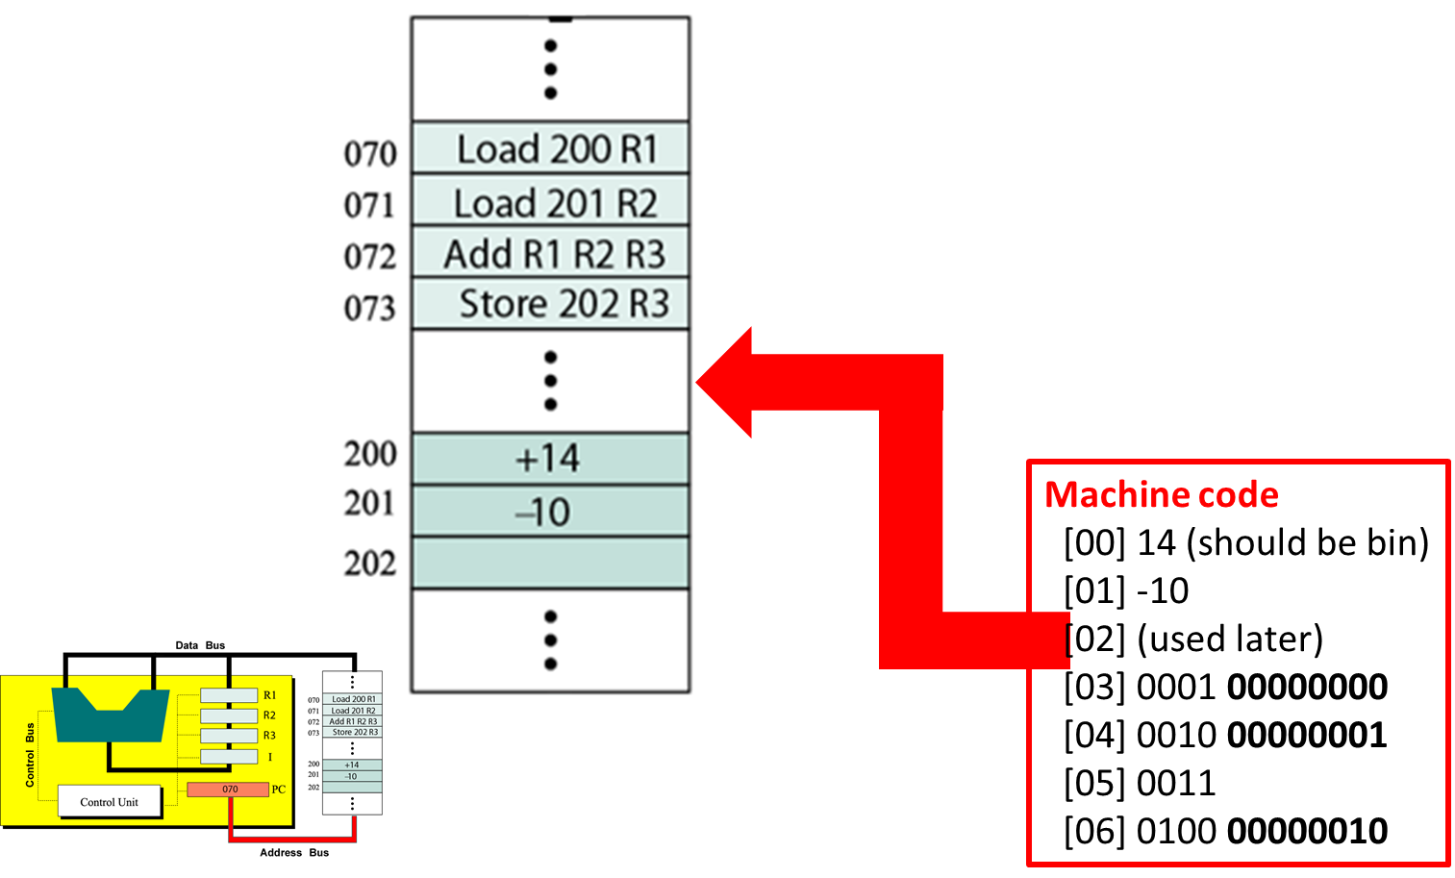
Where could we copy the program in MM?
We need information about the usage of MM first
If available, the program is copied into MM
We need information to locate the instructions in MM
We’ll learn this how in later chapter: MM

Slide 7
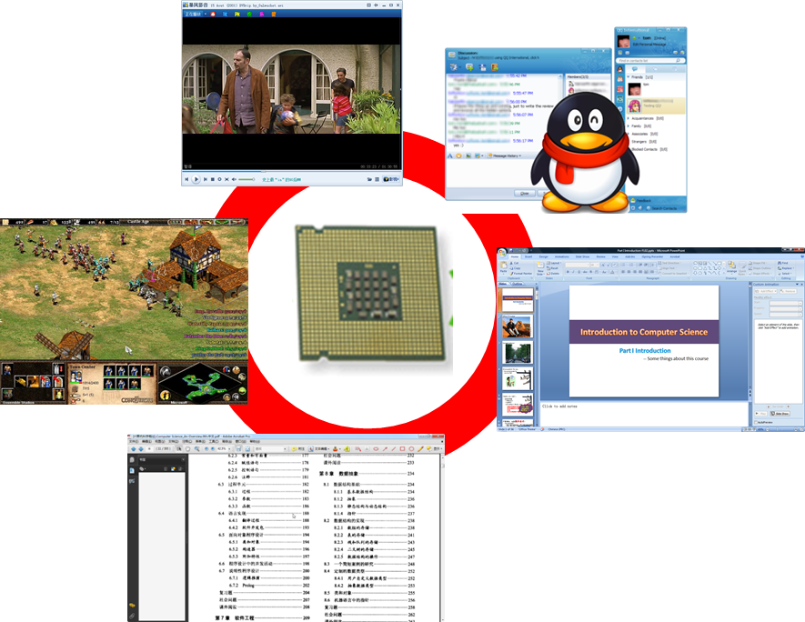
We also need to record the information of current instruction for CPU switching
The address of the instruction when CPU is switched, like 1031
We’ll learn this how in later chapter: CPU Scheduling

Slide 8
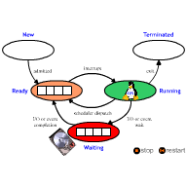
The execution of your program is alive

Slide 9
You have learned how to record that kind of information in programming.
Design the data structure!
PCB (Process Control Block) is the one used/named data structure
Process location information
Process identification information
Process state information
Process control information

Slide 10
PCB: Process Location Information
Process Location Information: Each process image in memory
may not occupy a contiguous range of addresses (depends on memory management scheme used, which will be discussed in later MM part).
both a private and shared memory address space can be used.
Process Identification Information: A few numeric identifiers may be used
Unique process identifier (PID) –
indexes (directly or indirectly) into the process table.
User identifier (UID) –
the user who is responsible for the job.
Identifier of the process that created this process (PPID).

Slide 11
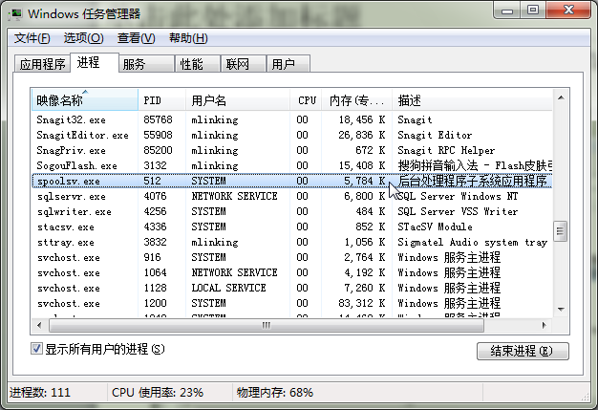
The process!

Slide 12
Eh? What’s the meaning of “Control” information here? – Because process is alive in OS!
Processor State Information: Contents of processor registers
User-visible registers
Control and status registers
Stack pointers
Process Control Information: Scheduling and state information
Process state (i.e., running, ready, blocked...)
Priority of the process
Relationship with other processes
the process is waiting (if blocked).
other PCBs for process queues, parent-child relationships and other structures

Slide 13
The execution of your program is alive

Slide 14
Program execution is dynamic→ Process has states
We’ll learn this how in later chapter: CPU Scheduling
As a process executes, it changes state.
The state of a process is defined in part by the current activity of that process.
Each process may be in one of the following states:
New. The process is being created.
Running. Instructions are being executed ←Get CPU.
Waiting. The process is waiting for some event to occur (such as an I/O completion or reception of a signal).
Ready. The process is waiting to be assigned to a processor.
Terminated. The process has finished execution.

Slide 15
Process Transitions (1)
Ready → Running
When it is time, the dispatcher selects a new process to run.
Running → Ready
the running process has expired his time slot.
the running process gets interrupted because a higher priority process is in the ready state.

Slide 16
Process Transitions (2)
Running → Waiting
When a process requests something for which it must wait:
a service that the OS is not ready to perform.
an access to a resource not yet available.
initiates I/O and must wait for the result.
waiting for a process to provide input.
Waiting → Ready
When the event for which it was waiting occurs.

Slide 17
PCB defined in Linux
PCB example
PCB in Linux is defined using a struct task_struct
There are many parameters in Linux’s PCB
The size of each PCB is usually a little larger than 1KB
struct task_struct{
...
unsigned short uid;
int pid;
int processor;
...
volatile long state;
long priority;
unsighed long rt_prority;
long counter;
unsigned long flags;
unsigned long policy;
...
Struct task_struct *next_task, *prev_task;
Struct task_struct *next_run,*prev_run;
Struct task_struct *p_opptr, *p_pptr, *p_cptr, *pysptr, *p_ptr;
...
};
http://keran.blog.51cto.com/409754/188471/

Slide 18
(2)int pid is the ID of the current process
(3)int processor: the CPU used by the current process. Support multi-processor
(4)volatile long state: corresponds to the states defined as follows：
Running (TASK-RUNING):可运行状态 ;
Interruptible state (TASK-IntERRUPTIBLE):可中断阻塞状态
Uninterruptible state (TASK-UNINTERRUPTIBLE):不可中断阻塞状态
Zombie (TASK-ZOMBIE):僵死状态
Stopped (TASK_STOPPED):暂停态
Swapping (TASK_SWAPPING):交换态
(5)long priority [进程的优先级]
(6)unsigned long rt_priority [实时进程的优先级，对于普通进程无效]
(7)long counter: a counter for counting the priority, used by Round Robin scheduling algorithm
http://keran.blog.51cto.com/409754/188471/

Slide 19
I hope you could infer the related operations for PCB data structure. You’ve been trained in DSA course
(8)unsigned long policy: Strategies for CPU scheduling ：
SCHED_OTHER( =0) Round Robin algorithm [普通进程优先级轮转法]
SCHED_FIFO( =1) RT FCFS algorithm [实时进程先来先服务算法]
SCHED_RR( =2) RT Priority algorithm [实时进程优先级轮转法]
(9)struct task_struct *next_task,*prev_task: pointers for PCB’s Double linked lists [进程PCB双向链表的前后项指针]
(10)struct task_struct *next_run,*prev_run: pointers for the PCBs in ready queue [就绪队列双向链表的前后项指针]
(11)struct task_struct *p_opptr,*p_pptr,*p_cptr,*p_ysptr,*p_ptr: relations among the process family [指明进程家族间的关系，分别为指向祖父进程、父进程、子进程以及新老进程的指针]
http://keran.blog.51cto.com/409754/188471/

Slide 20
Process
To understand the execution of your program
Process [进程] is the traditional concept
The identification to manage the needed information to run one program
PCB is the data structure to record the necessary information: resources (MM, ownership, security, …), execution stages/states, …
Additional data structures and algorithms are needed to manage the concurrent execution of many programs
Queues, and schedulers
Inter-process communication (IPC)
Thread[线程] is the modern concept
The idea could be seen as Multiplexing process, namely that your program is constructed to have more than one execution units
CPU is occupied by the process, however the usage of the CPU is shared among the internal execution units (threads)
The resources assigned to the process could be shared by those threads.
Notes:
[2015年3月24日13:23:14 逸夫西楼811] 之前大概了解了进程的概念。对于后续CPU Scheduling 以及 Synchronization 内容的理解， 了解程序在 OS 内部管理中的动态 (Dynamics)， 以及它们相互间协作 (Cooperation)进而如何安全的 Synchronization （Data Inconsistency 和 Deadlock） 是非常必要的

Slide 21
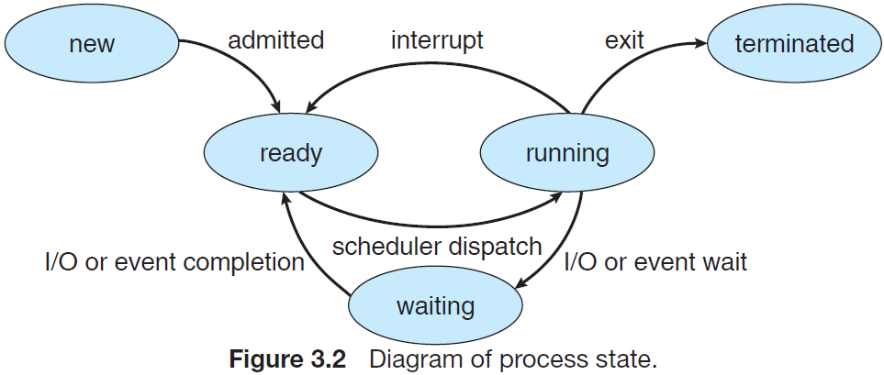
Five-State Model
Since usually there may be several processes in these states, some data structures are needed to represent those state-related processes
It’s also OK to use following 5 states: Running, Ready, Blocked, New, Exit

Slide 22

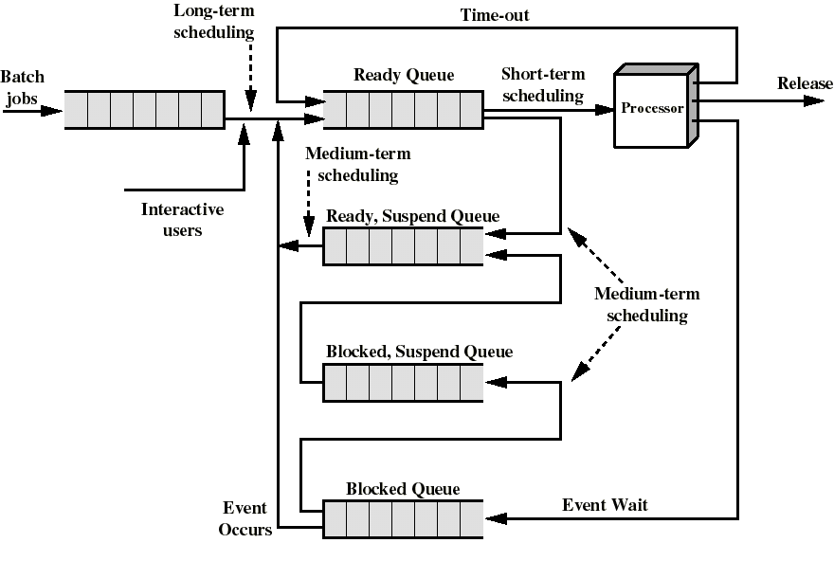
Supplement: Data structures to manage those state-related processes
Queue! ← You have learned it
I think you remember how to move PCBs among these queues, right?

Slide 23
Three kinds of schedulers
Long-term scheduler (jobs scheduler) – selects which programs/processes should be brought into the ready queue.
Medium-term scheduler (emergency scheduler) – selects which job/process should be swapped out if system is loaded.
Short-term scheduler (CPU scheduler) – selects which process should be executed next and allocates CPU.
PPTs from others\From Ariel J. Frank\OS381\os3-2.ppt

Slide 24
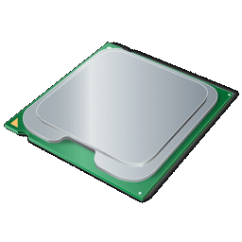

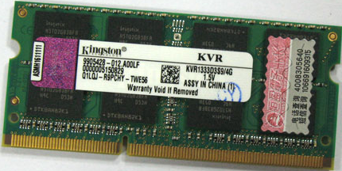
Those queues are used by Three kinds of schedulers
Main Memory
Storage media
(Magnetic disk)
CPU
Long-term scheduler determines which jobs could be transited into main memory
Short-term scheduler determines which processes could get the usage of CPU

Slide 25
Three kinds of schedulers
Main Memory
Storage media
(Magnetic disk)
CPU
Mid-term scheduler is responsible to swap some processes out of memory or CPU usage
Data structures to store the swapped out processes
Notes:
Mid-term scheduler is responsible to swap some processes out of memory or CPU usage so that to keep the number of processes in the system on a robust level.

Slide 26
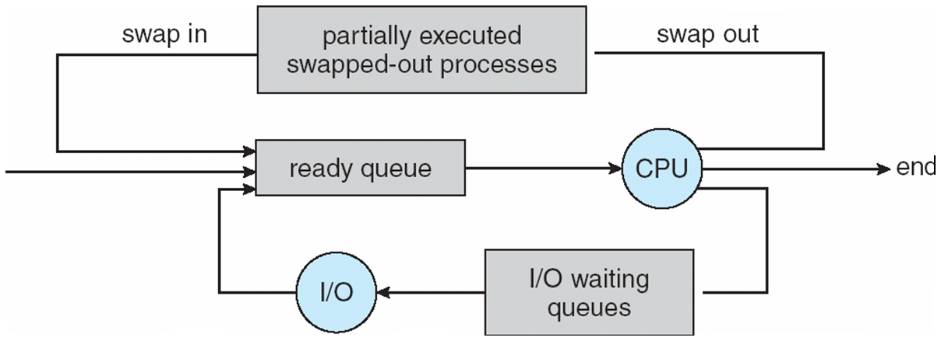
— Addition of Medium Term Scheduling
Medium-Term Scheduling
Medium-term
Short- term
Long-term
* Queueing diagram : A common representation for discussion for of process scheduling is a queueing diagram

Slide 27
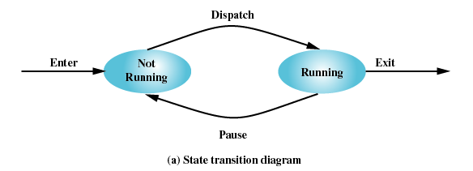
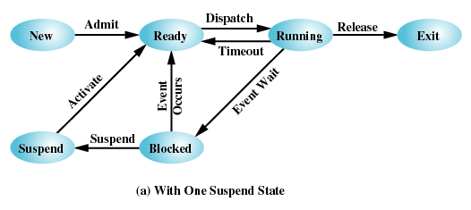
Summary: Sketch of the control for processes
The execution of a process goes through several states
New, Ready, Running, Waiting, Terminated [Five state model]
There are many different models for state transitions
Two state model:
Running, Not-running
Three state model:
Ready, Running, blocked
Five state model
Six state model
Other models

Slide 28
Suspended Processes
Processor is faster than I/O so all processes could be waiting for I/O
Swap these processes to disk to free up more memory
Blocked state becomes suspend state when swapped to disk
Two new states
Blocked/Suspend
Ready/Suspend
The strategy to select which process is swapped out, corresponds to the midterm scheduling [中期调度]
Notes:
We’ll discuss “midterm scheduling” later in process operations

Slide 29
Process
To understand the execution of your program
Process [进程] is the traditional concept
The identification to manage the needed information to run one program
PCB is the data structure to record the necessary information: resources (MM, ownership, security, …), execution stages/states, …
Additional data structures and algorithms are needed to manage the concurrent execution of many programs
Queues, and schedulers
Inter-process communication (IPC)
Thread[线程] is the modern concept
The idea could be seen as Multiplexing process, namely that your program is constructed to have more than one execution units
CPU is occupied by the process, however the usage of the CPU is shared among the internal execution units (threads)
The resources assigned to the process could be shared by those threads.

Slide 30

Concurrency OF COURSE benefits users!
This is of course not FREE! The cooperation leads to complexity – deadlock and data inconsistency in later chapters
Concurrent processes executing in the operating system allows for the processes to cooperate (both mutually or destructively) with other processes
The simplest example of how this can happen is where two processes are using the same file
Reasons for cooperating processes:
Several processes may need to access the same data (such as stored in a file)
Information sharing
Computation speed-up
Modularity
Convenience
Notes:
[2016年3月10日21:08:58] 之前一直觉得这部分嵌在这里有些生硬, 今天想到, 这一介绍 支持并发也是有好处的 – 协作完成某一任务!
[2014-03-01 1:13@西门之外]
http://www.classes.cs.uchicago.edu/archive/2014/winter/51081-1/LabFAQ/lab7/IPC.html
Cooperation
Concurrent processes executing in the operating system allows for the processes to cooperate (both mutually or destructively) with other processes. Processes are cooperating if they can affect each other. The simplest example of how this can happen is where two processes are using the same file. One process may be writing to a file, while another process is reading from the file; so, what is being read may be affected by what is being written. Processes cooperate by sharing data. Cooperation is important for several reasons:
Information sharing: Several processes may need to access the same data (such as stored in a file.)
Computation speedup: A task can ofter be run faster if it is broken into subtasks and distributed among different processes. For example, the matrix multiplication code we saw in class. This depends upon the processes sharing data. (Of course, real speedup also required having multiple CPUs that can be shared as well.) For another example, consider a webserver which may be serving many clients. Each client can have their own process or thread helping them. This allows the server to use the operating system to destribute the computer's resources, including CPU time, among the many clients.
Modularity: It may be easier to organize a complex task into separate subtasks, then have different processes or threads running each subtask. For example, a single server process dedicated to a single client may have multiple threads running--each performing a different task for the client.
Convenience: An individual user can run several programs at the same time, to perform some task. For example, a network browser is open, while the user has a remote terminal program running (such as telnet), and a word processing program editing data.
Cooperation between processes requires mechanisms that allow processes to communicate data between each other and synchronize their actions so they do not harmfully interfere with each other. The purpose of this note is to consider ways that processes can communicate data with each other, called Interprocess Communcation (IPC). Another note will discuss process synchronization, and in particular, the most important means of synchronizing activity, the use of semaphores.

Slide 31
IPC: Inter-Process Communication
Cooperating processes require an inter-process communication (IPC) mechanism that will allow them to exchange data and information.
There are two fundamental models of inter-process communication:
Shared memory
Message passing
message passing interfaces, mailboxes and message queues
sockets, STREAMS, pipes

Slide 32
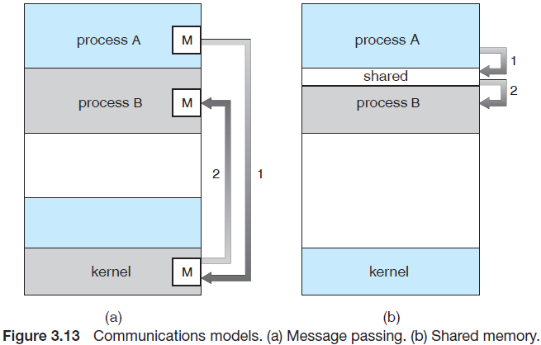
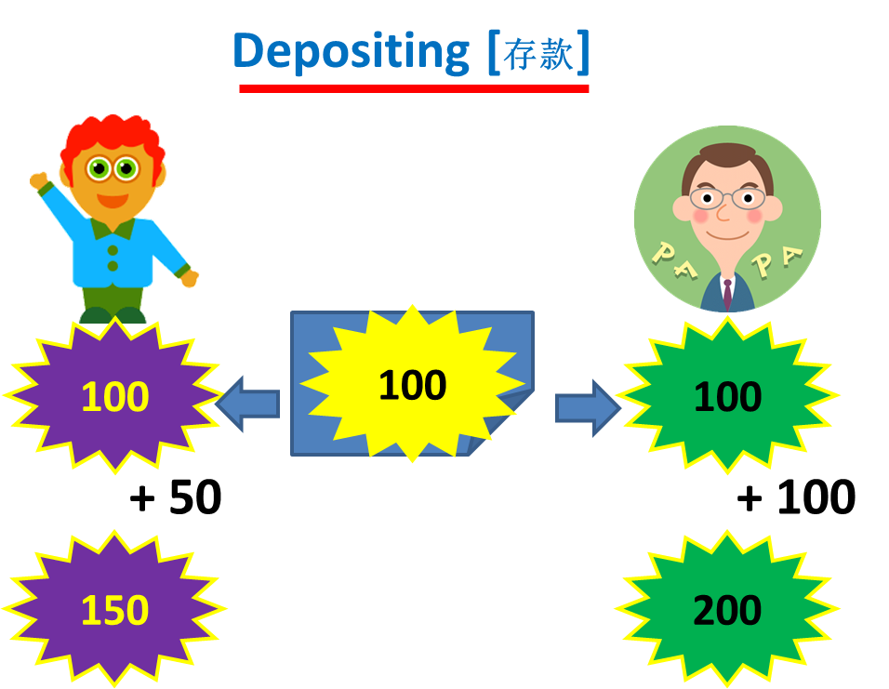
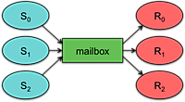
IPC: two fundamental types
Both of the models just discussed are common in operating systems, and many systems implement them both.

Slide 33
Process
To understand the execution of your program
Process [进程] is the traditional concept
The identification to manage the needed information to run one program
PCB is the data structure to record the necessary information: resources (MM, ownership, security, …), execution stages/states, …
Additional data structures and algorithms are needed to manage the concurrent execution of many programs
Queues, and schedulers
Inter-process communication (IPC)
Thread[线程] is the modern concept
The idea could be seen as Multiplexing process, namely that your program is constructed to have more than one execution units
CPU is occupied by the process, however the usage of the CPU is shared among the internal execution units (threads)
The resources assigned to the process could be shared by those threads.

Slide 34
Context Switching
Process switching is expenSive!
Program instructions operate on operands in memory and (temporarily) in registers
Memory
Load A1, R1
Load A2, R2
Add R1, R2, R3
Store R3, A3
…
CPU
Prog2
Code
ALU
Prog1
Code
Prog2
Data
Prog1
Data
SP
PC
Prog1 has CPU
Prog2 is suspended
Prog2
State
Notes:
http://www.csd.uwo.ca/courses/CS3305b/lectures.html
[2017年3月1日15:35:22 今天试了下, 原来的东西不能访问了]
新的课程网址 是 http://www.csd.uwo.ca/courses/CS3305b/CS%203305B%20Homepage.htm
但是, 课件都是 PDF 的了

Slide 35
Context Switching
Saving all the information about a process allows a process to be temporarily suspended and later resumed from the same point
Memory
CPU
Prog2
Code
ALU
Prog1
Code
Prog2
Data
Prog1
Data
SP
PC
OS suspends Prog1
Prog1
State
Prog2
State

Slide 36
Context Switching
Saving all the information about a process allows a process to be temporarily suspended and later resumed
Memory
CPU
Prog2
Code
ALU
Prog1
Code
Prog2
Data
Prog1
Data
SP
PC
OS resumes Prog2
Prog1
State
Prog2
State

Slide 37
Context Switching
Program instructions operate on operands in memory and in registers
Memory
Load A1, R1
Load A2, R2
Sub R1, R2, R3
Store R3, A3
…
CPU
Prog2
Code
ALU
Prog1
Code
Prog2
Data
Prog1
Data
SP
PC
Prog2 has CPU
Prog1 is suspended
Prog1
State

Slide 38
How to overcome the cost? Share - Analogous with DLL
P1
Three programs (P1, P2, P3) share same DLL (lib1)
Namely, there is only a copy of the functions defined in lib1 in the MM
And, those programs may access different function in lib1
➔ So, each program should remember some information of the target functions (called Context[上下文]) in lib1
P2
Main Memory
P3
Lib1 (DLL)
Notes:
https://zhidao.baidu.com/question/1991976523222417347.html?qbl=relate_question_2&word=Context%20Switching
上下文切换（Context Switch） 或者环境切换 在操作系统中，CPU切换到另一个进程需要保存当前进程的状态并恢复另一个进程的状态：当前运行任务转为就绪（或者挂起、删除）状态，另一个被选定的就绪任务成为当前任务。上下文切换包括保存当前任务的运行环境，恢复将要运行任务的运行环境。 进程上下文用进程的PCB（进程控制块,也称为PCB，即任务控制块）表示，它包括进程状态，CPU寄存器的值等。 通常通过执行一个状态保存来保存CPU当前状态，然后执行一个状态恢复重新开始运行。
支持多任务处理是CPU设计史上最大的跨越之一。在计算机中，多任务处理是指同时运行两个或多个程序。从使用者的角度来看，这看起来并不复杂或者难以实现，但是它确实是计算机设计史上一次大的飞跃。在多任务处理系统中，CPU需要处理所有程序的操作，当用户来回切换它们时，需要记录这些程序执行到哪里。上下文切换就是这样一个过程，他允许CPU记录并恢复各种正在运行程序的状态，使它能够完成切换操作。
在上下文切换过程中，CPU会停止处理当前运行的程序，并保存当前程序运行的具体位置以便之后继续运行。从这个角度来看，上下文切换有点像我们同时阅读几本书，在来回切换书本的同时我们需要记住每本书当前读到的页码。在程序中，上下文切换过程中的“页码”信息是保存在进程控制块（PCB）中的。PCB还经常被称作“切换桢”（switchframe）。“页码”信息会一直保存到CPU的内存中，直到他们被再次使用。
在三种情况下可能会发生上下文切换：中断处理，多任务处理，用户态切换。在中断处理中，其他程序”打断”了当前正在运行的程序。当CPU接收到中断请求时，会在正在运行的程序和发起中断请求的程序之间进行一次上下文切换。在多任务处理中，CPU会在不同程序之间来回切换，每个程序都有相应的处理时间片，CPU在两个时间片的间隔中进行上下文切换。对于一些操作系统，当进行用户态切换时也会进行一次上下文切换，虽然这不是必须的。

Slide 39
Share + Context: multiple services in one program
We can use 1 CPU + 1 MM space + 1 HD to support Multiprogramming – the basis of modern OSs, namely concurrently running many processes
How about providing multiple services with one program? (Multiserving?)
If so, there is only one copy of the instructions of those server programs or MS Word in MM, which can provide services for many users/requests
⬅ This is obviously economical and efficient way!
Notes:
[2014-03-06 22:31 @XiMen] Multiserving:自己造的词, 呵呵

Slide 40
Here comes thread
Concept of Process has two facets.
A Process is:
A Unit of resource ownership – process is allocated:
a virtual address space for the process image
control of some resources (files, I/O devices...)
A Unit of execution/dispatching - process is an execution path through one or more programs (functions, code segments)
may be interleaved with other processes
execution state (Ready, Running, Blocked...) and dispatching priority
PPTs from others\flame.cs.dal.ca_~hawkey_3120\June30Threads.ppt

Slide 41
These two characteristics are treated separately by some recent operating systems:
The unit of resource ownership is referred to as a Task or (for historical reasons) also as a Process.
The unit of dispatching is referred to a Thread.
➔ A thread is an execution unit inside a process/program, which could be scheduled directly for CPU (this depends on the OS)
Several threads can exist as services in the same task/process.
PPTs from others\flame.cs.dal.ca_~hawkey_3120\June30Threads.ppt
PPTs from others\From Ariel J. Frank\OS381\os3-3_pro.ppt

Slide 42

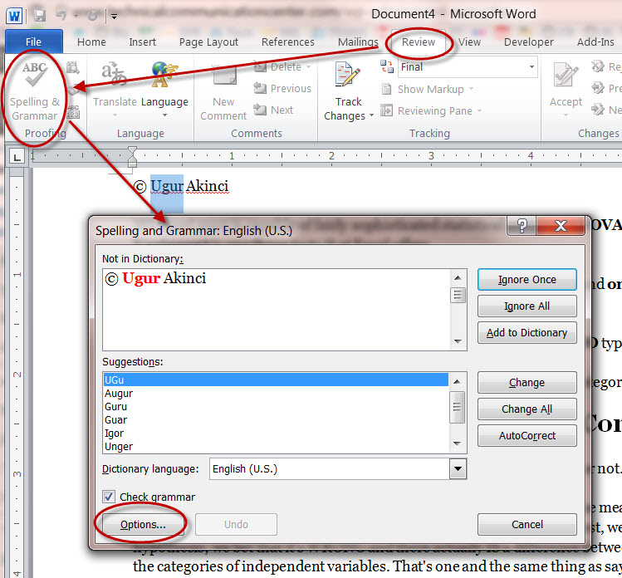


You’ve experienced THREAD
MS Word
If you want to edit M documents, it is definitely too expensive to run M MS Words for those documents!
They can share the instructions of MS Word!

Slide 43
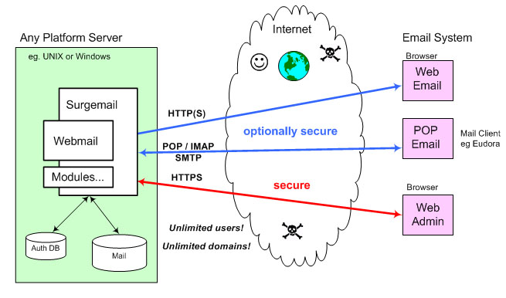
Thread now is popular, especially for high performance servers
Web server, FTP server, DBMS server, e-mail server, …
N users access those servers, and if we prepare N server processes for each user.
It’s definitely too expensive to create many servers to respond those users
They can share the instructions of the server

Slide 44
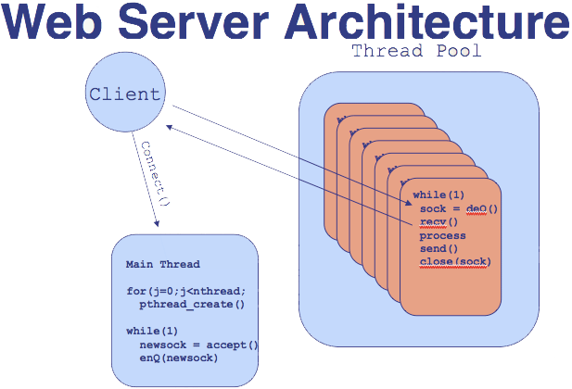
Here is a sketch of Web server architecture
Web server runs as a daemon [ˈdi:mən] program
When a client connects the server, the server provides the service for the client
The multiple services provided by the program can be seen as Thread
Notes:
[创建很多的 “线程”, 它们共享处理的指令]

Slide 45
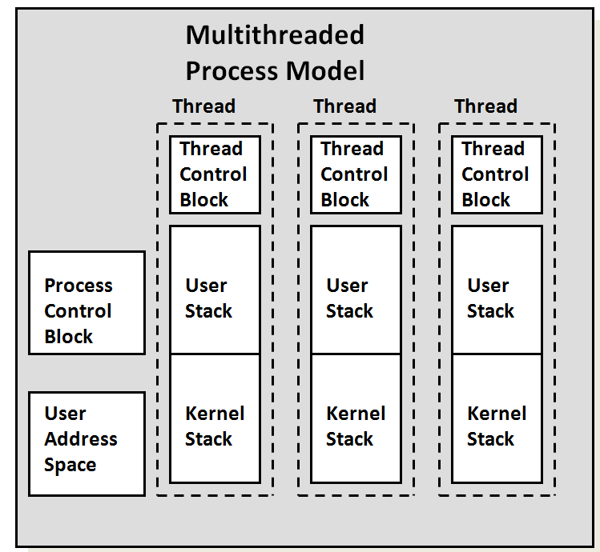
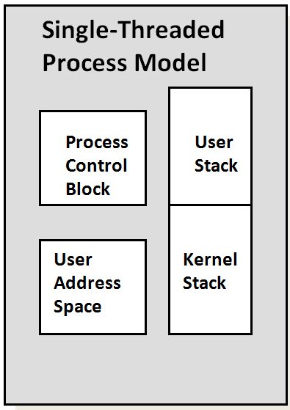
Single Threaded and Multithreaded Process Models
Thread Control Block (TCB) contains a register image, thread priority and thread state information
PPTs from others\Operating Systems\Processes.ppt

Slide 46
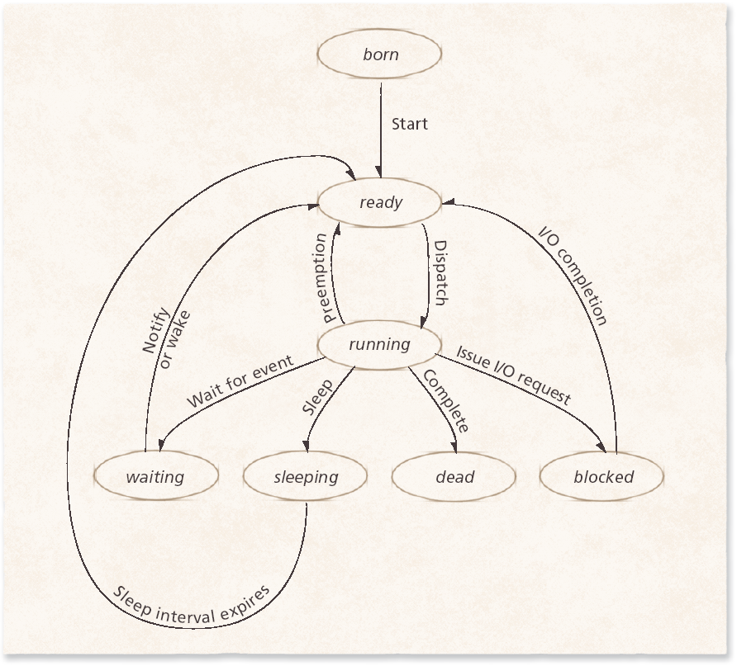
Thread States: Life Cycle of a Thread
Figure 4.2 Thread life cycle.
Also need scheduling strategies here!
PPTs from others\Deitel OS3e-users.cis.fiu.edu_~ege_cop5994_slides_Deitel - OS 3rd edition\OS3e_04.ppt

Slide 47
Thread Operations
Threads and processes have common operations
Create, Exit (terminate), Suspend, Resume, Sleep, Wake
Thread operations do not correspond precisely to process operations
Cancel
Indicates that a thread should be terminated, but does not guarantee that the thread will be terminated
Threads can mask the cancellation signal
Join
A primary thread can wait for all other threads to exit by joining them
The joining thread blocks until the thread it joined exits
PPTs from others\Deitel OS3e-users.cis.fiu.edu_~ege_cop5994_slides_Deitel - OS 3rd edition\OS3e_04.ppt

Slide 48
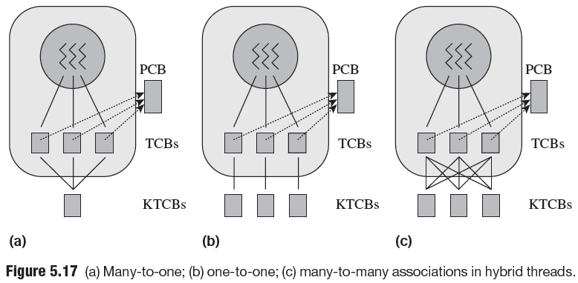
Thread libraries
To implement threads, a threading library (either in user space or kernel space) is responsible for handling the saving and switching of the execution context from one thread to another.
We have ULT (User-Level Thread) and KLT (Kernel-Level Thread).
Multithreaded application
ULT type
KLT type

Slide 49
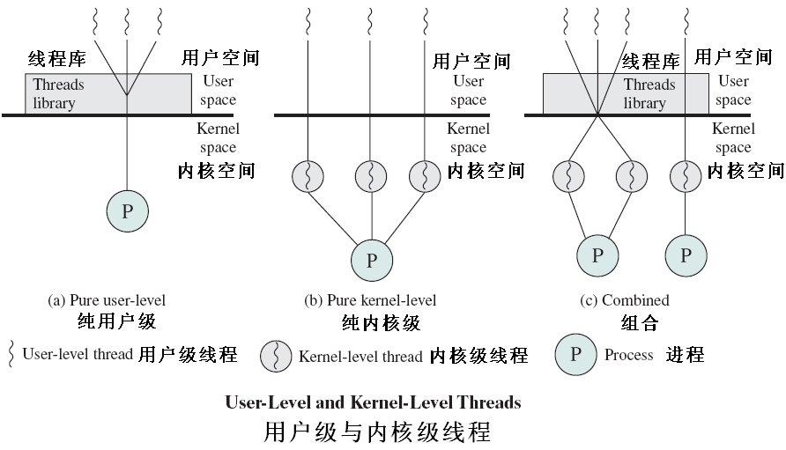

Slide 50
Threads library
Contains code for:
creating and destroying threads
passing messages and data between threads
scheduling thread execution
pass control from one thread to another
saving and restoring thread contexts
ULT can be implemented on any Operating System, because no kernel services are required to support them
POSIX Pthreads, Mach C-threads, Solaris UI-threads
PPTs from others\flame.cs.dal.ca_~hawkey_3120\June30Threads.ppt

Slide 51


POSIX and Pthreads
Pthreads, the threads extension of the POSIX standard, may be provided as either a user- or kernel-level library
POSIX states that processor registers, stack and signal mask are maintained individually for each thread
POSIX specifies how operating systems should deliver signals to Pthreads in addition to specifying several thread-cancellation modes
We’ve seen Java thread
PPTs from others\Deitel OS3e-users.cis.fiu.edu_~ege_cop5994_slides_Deitel - OS 3rd edition\OS3e_04.ppt
Notes:
I really want to know the design and implementation of this kind of libraries! Could you help me/us?

Slide 52
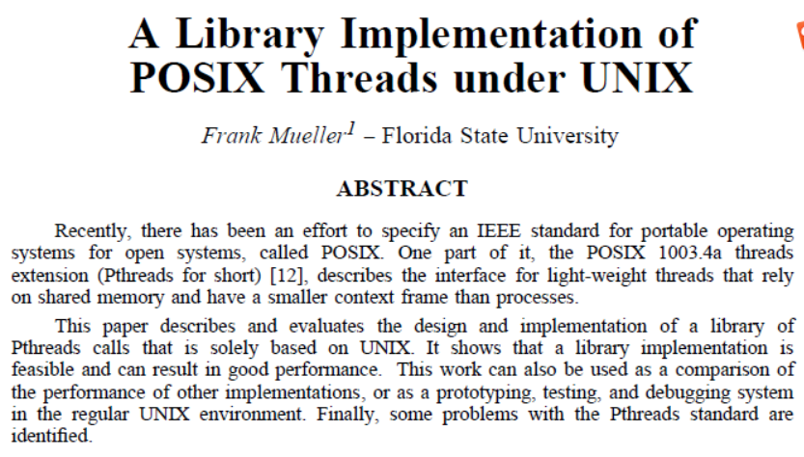
Who wants to read for us? ☺

Slide 53

作者: Bill Lewis / SunSoft Press / Daniel J. Berg 出版社: Prentice Hall PTR 副标题: A Guide to Multithreaded Programming 出版年: 1995-10-31 页数: 352 定价: USD 60.00 装帧: Paperback ISBN: 9780134436982

Slide 54

Win32 Threads (Windows XP)
The Win32 thread library is a kernel-level library available on Windows systems
Actual unit of execution dispatched to a processor
Execute a piece of the process’s code in the process’s context, using the process’s resources
Execution context contains
Runtime stack
State of the machine’s registers
Several attributes
PPTs from others\Deitel OS3e-users.cis.fiu.edu_~ege_cop5994_slides_Deitel - OS 3rd edition\OS3e_04.ppt

Slide 55
Java Threads
Java allows the application programmer to create threads that can port to many computing platforms
Threads
Created by class Thread
Execute code specified in a Runnable object’s run method
Java supports operations such as naming, starting and joining threads
PPTs from others\Deitel OS3e-users.cis.fiu.edu_~ege_cop5994_slides_Deitel - OS 3rd edition\OS3e_04.ppt

Slide 56
The Java thread API allows threads to be created and managed directly in Java programs
However, because inmost instances the JVM is running on top of a host operating system, the Java thread API is generally implemented using a thread library available on the host system.
→This means that on Windows systems, Java threads are typically implemented using the Win32 API; UNIX and Linux systems often use Pthreads

Slide 57

Java Threads
Example showing interleaved thread execution : class SimpleThread extends Thread { public SimpleThread (String str) { // superclass constructor super (str); } public void run () { for (int i=0; i<10; i++) { System.out.println (i + “ “ + getName() ); try { sleep ((int) (Math.random () * 1000)); catch (InterruptedException e) { } } System.out.println (“Finished “ + getName () ); } } class TwoThreadsTest { public static void main (String[ ] args) { new SimpleThread (“Edinburgh”).start (); new SimpleThread (“Glasgow”).start (); } }
PPTs from others\www.dcs.ed.ac.uk_teaching_cs3_osslides\thread.ppt

Slide 58
main method starts two threads by calling the start method
output something like :
0 Edinburgh 0 Glasgow 1 Glasgow 1 Edinburgh 2 Edinburgh 3 Edinburgh 2 Glasgow 3 Glasgow 4 Glasgow 4 Edinburgh 5 Glasgow 5 Edinburgh 6 Glasgow 7 Glasgow 8 Glasgow 6 Edinburgh 7 Edinburgh 8 Edinburgh 9 Edinburgh Finished Edinburgh 9 Glasgow Finished Glasgow
You can use the experiment framework of this course to simulate this , right?
PPTs from others\www.dcs.ed.ac.uk_teaching_cs3_osslides\thread.ppt

